Slide 1
St patrICK’S DAY!
AN IRISH HOLIDAY!

Slide 2
WHEN?
ST. PATRICK’S DAY IS CELEBRATED ON THE 17° OF MARCH

Slide 3
WHERE?
ST. PATRICK IS THE PATRON SAIT OF IRELAND AND HERE CELEBRATED ST. PATRICK’S DAY

Slide 4
SYMBOLS
THE MOST FAMOUS SYMBOLS ARE: THE SHAMROCK,CELTIC CROSSES,SNAKES AND LEPRECHAUN

Slide 5
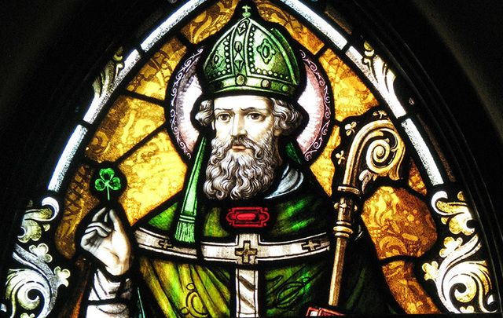
WHO IS ST.PATRICK?
HE WAS A MISSIONARY AND THE BISHOP OF IRELAND,HE IS THE FIRST PATRON SAID OF IRELAND AND HE IS VENERATED BY LOTS OF
CHURCHES

