Slide 1
HALLOWEEN
Its history, Jack o’ Lantern’s story, its customs and its stereotypes

Slide 2
HISTORY
The Celts, like other ancient peoples, measure time according to the seasons and harvest cycles, just as Semhain was the party that marked the end of summer and the other time before the last harvest before The beginning of cold season, the occasion in which provisions are made to face the cold northern winter. For this reason Semhain was the most important festival for the Celts and represented a moment of passage, out of time. From this derives the mortuary character of the feast of Semhain, which we will find again in modern Halloween: in this moment in between the Celts in fact believed that the wall that divides the realm of the dead from that of the living thin and that the two worlds could enter into communication : the dead have returned to the world of the living and come into contact with them. This is why the Semhain festival was also a time to honor the dead.

Slide 3
JACK O’LANTERN’S STORY
The tradition of carving pumpkins, a true Halloween icon, most likely dates back to Irish folklore. The custom is linked to the famous Irish legend of Jack, a miser and drunkard blacksmith, who one day at the bar met the devil. Because of the dissolute life, his soul was already destined for the devil. Thanks to his cunning and in exchange for his soul, he managed to make it turn into a coin for a last drink. But Jack put the devil in his purse, next to a silver cross, so that he could not change back. The latter, in order to get his freedom back, promised that he would not take his soul for the next ten years. The deal was successful and Jack released him. Once the ten years had passed, the devil appeared again. But before giving him his soul, Jack made one last wish: he asked him to pick an apple from a tree. But to keep it from coming down, he carved a cross on the tree trunk. He had cheated her again. So there was another bargaining and in exchange for freedom, the devil should have saved him from eternal damnation. At his death, due to the innumerable sins, Jack was rejected by Paradise, but in the same way, having made the pact with the devil, he was also rejected by Hell. Finally the Satan had his revenge! Jack would have been forced to spend eternity as a tormented soul, without any destination. To make him enlighten the way, the devil threw him a burning ember, which Jack put into a turnip he had with him to make it last longer. Hence the name of Jack O ’Lantern,

Slide 4
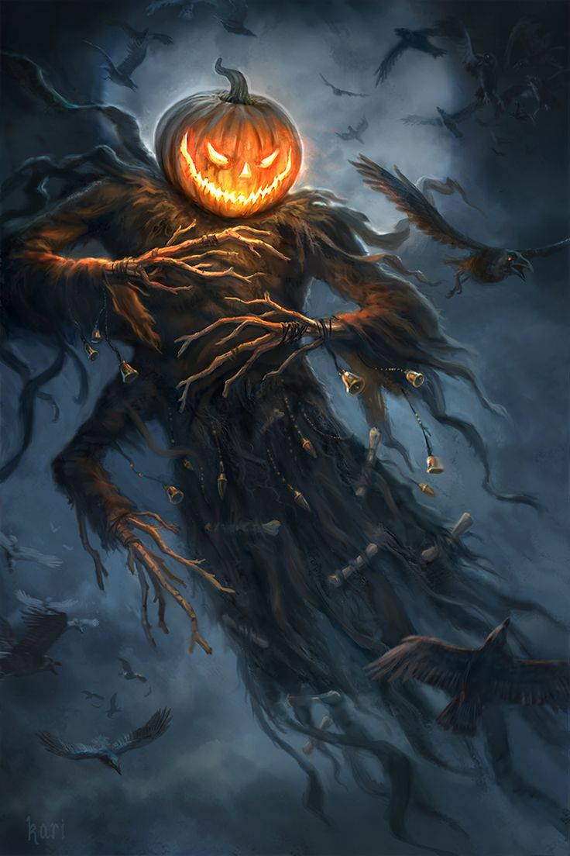
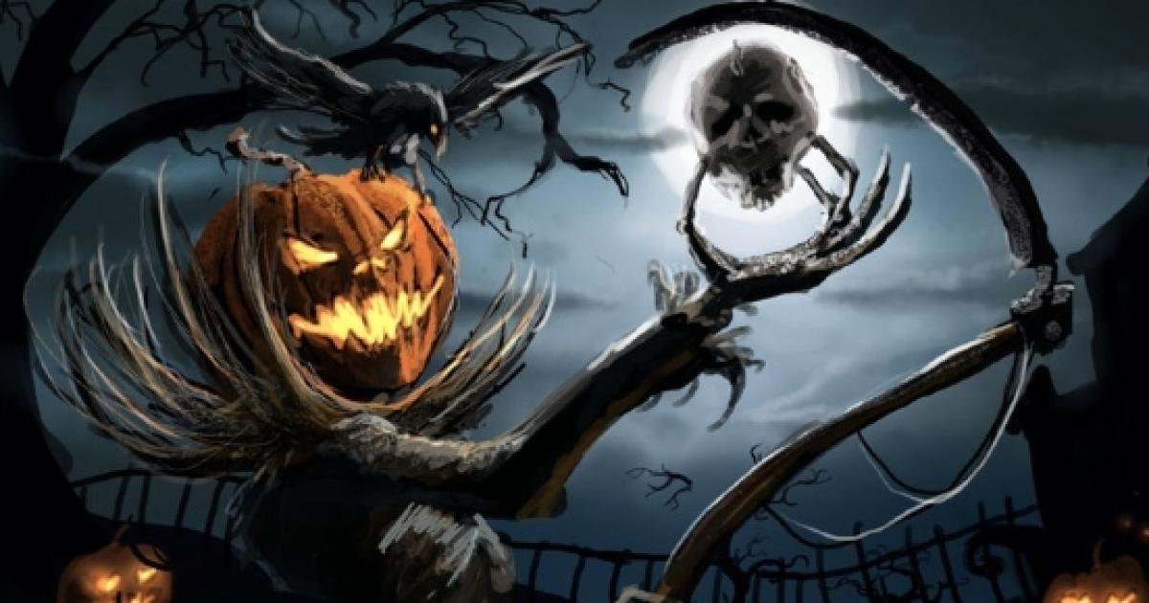
IMAGES
OF JACK O’LANTERN

Slide 5
CUSTOMS
According to the association of American traders, about 40% of the American population is traversed every year, for a total of 120 million individuals among children, adults and even pets: more than 11 percent of American dogs or cats he comes - in spite of himself - in disguise. Here are the most popular costumes among adults in 2010: Witch, Vampire, Pirate, Nurse, Sexy Vamp, Cat, Zombies, Fairy, Athlete / Batman, Dracula. While these were the ten most popular costumes among children in the same year: Princess, Spider-Man, Witch, Pirate, Disney Princess, Superhero, Phantonjj , Pumpkin / Vampire, Batman, Star Wars character.

Slide 6
STEREOTYPES
The main stereotypes of halloween are the pumpkins, black mask, the candies, the costumes from monsters or fantastic creatures and the broken mirrors. Some of the most famous ‘ animated ‘ stereotypes are children who go to knock on doors saying the usual sentence ‘ Trick or Treat? ‘ , monsters, witches, vampires, ghosts, werewolves and black cats.

Slide 7
Fatto da
Tommaso De Pascale
E
Alessandro Sessa

