Slide 1
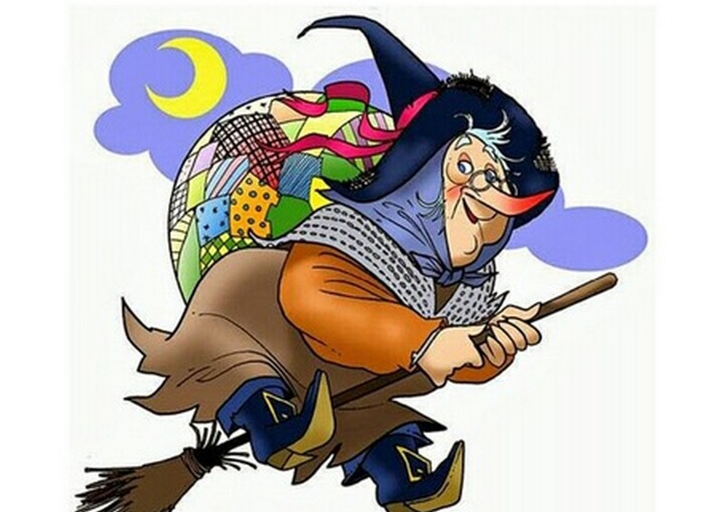
THE EPIPHANY

Slide 2
The witch comes at night and brings so much candy to all the good children.She wears a long black skirt and a black cap.The witch has a very big nose.The witch has a big bag wheree she puts au the candy.The epiphany is celebrated on the 6° of Jannuary

Slide 3
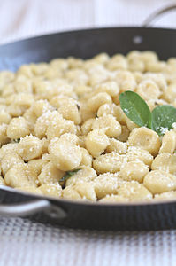
THE WITCH COMES AT NIGHT WITH HER SHOES ALL BROKEN AND HER DRESS HERE COMES THE «BEFANA».
(This is the little song for the «befana»).

Slide 4
During the Epiphany lunch in our home we eat the appetizer or the so called «BROOM OF THE WITCH». As a main instead ,we have the «STUFFED GNOCCHI – A UNIQUE GOODNESS..!!» As a second course we have the «ROAST BEEF» finally to complete the lunch we eat the «CHARCOAL FROM THE EPIPHANY».

Slide 5
She is therefore not bad she is just annoyed with adults and rude to those who don’t like her ,because they try to be smart ; but with the children she shows herself with warmth and lack understanding –a granny full of attention and gifts .

Slide 6
The BEFANA recalls the religions traditions of S.Lucia.

Slide 7
CREATED BY:
FRANCESCA GIORDANO
FERRAIOLI DENISE MARIA
PASCALE ANNAMANOLA

